Slide 1
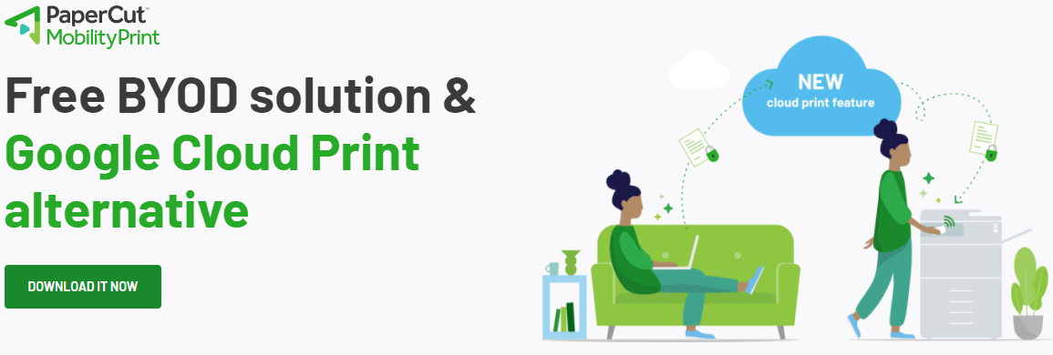
PaperCut Mobility Print
https://www.papercut.com/products/free-software/mobility-print/#downloadSection
Please select your OS version to start your download after clicking this link.

Slide 2

What is PaperCut Mobility print?

Slide 3

How to set up printing Mobility Print

Slide 4
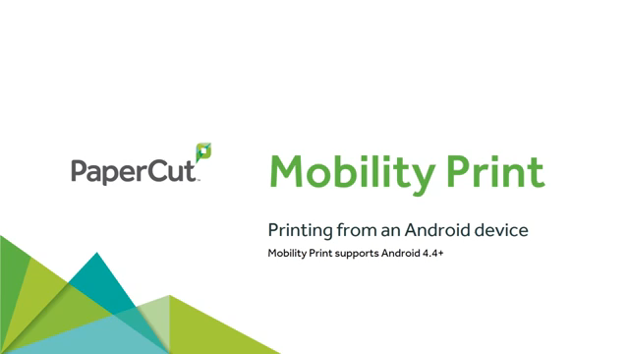
Android Printing

Slide 5

iOS Printing

Slide 6

Mac Printing

Slide 7

Cloud Print Setup

Slide 8
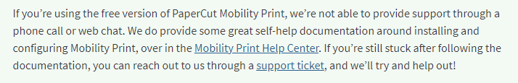
PaperCut Mobility print support
Although this is a good alternative to Google Cloud Print, Metro Sales Inc. does not support this directly. You will need to use the contact information below for support.
Mobility Print Help Center https://www.papercut.com/support/resources/manuals/mobility-print/mobility-print-server/topics/installation.html
Support ticket
https://support.papercut.com/

